Slide 1
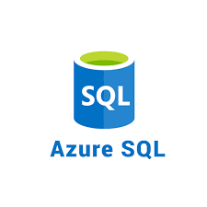

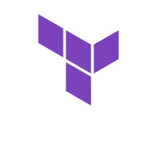


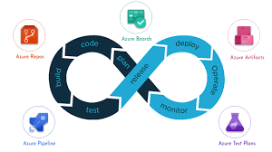
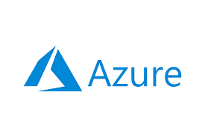
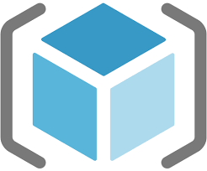
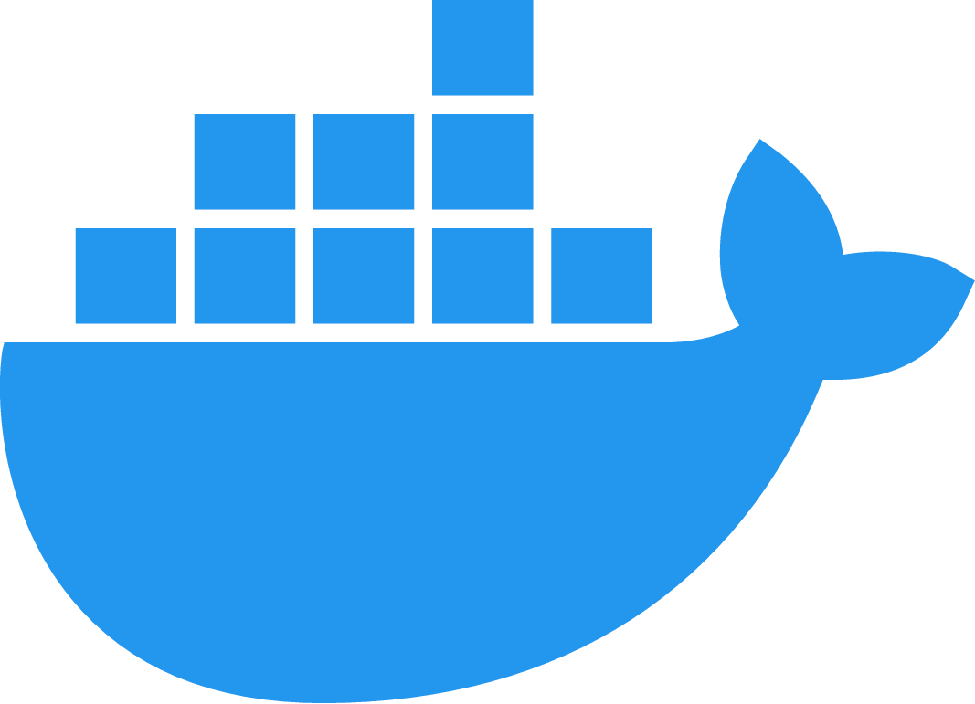

Azure Compute Services

Slide 2

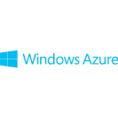
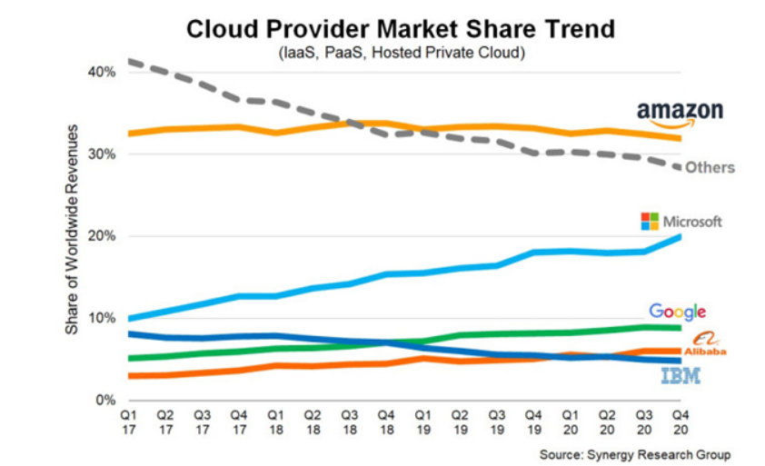
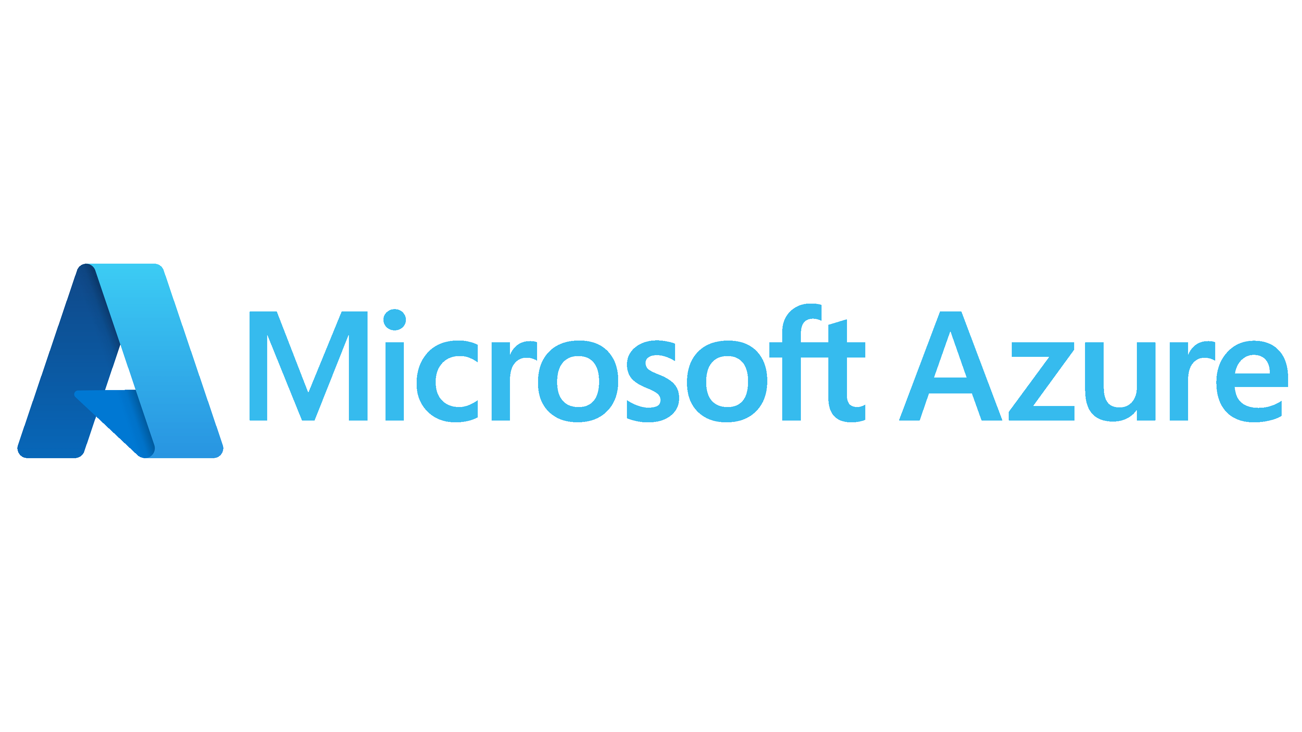
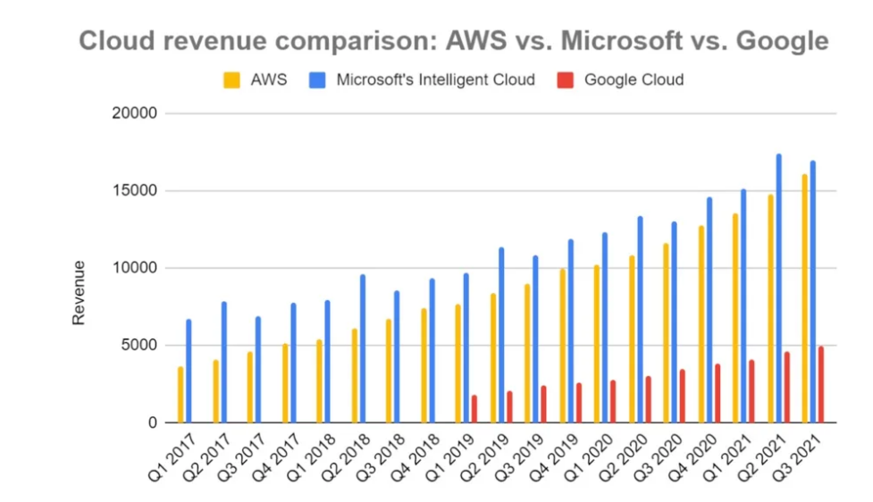
Azure Cloud Services
Why Microsoft Azure?
Launched in 2010 as
Renamed in 2014 as
URL For azure cloud -- https://portal.azure.com
Azure Regions - https://azure.microsoft.com/en-us/global-infrastructure/geographies/#geographies

Slide 3
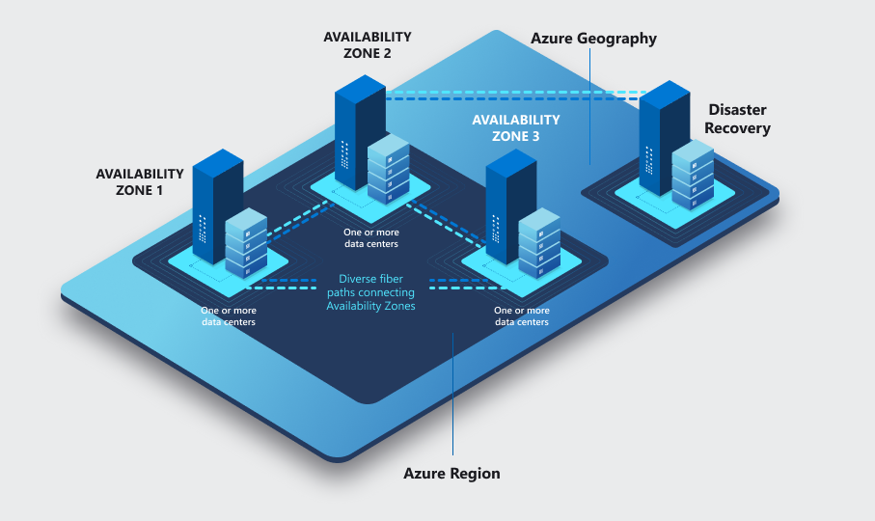

Azure Cloud Services
Azure cloud Key terms
Subscription- an agreement between organization and Microsoft to use resources.
Resource Groups- a logical container that holds related resources for an Azure solution
Regions- a set of datacentres deployed within an interval-defined perimeter and
connected through a dedicated regional low-latency network
Availability Zones- connected by a high-performance network
with a round-trip latency of less than 2ms
Azure Resource Manager- is the deployment and management service for Azure.
It provides a management layer that enables you to create, update, and delete resources in your Azure account
Azure CLI- a cross-platform command-line tool to connect to Azure and execute administrative commands on Azure resources
Cloud Shell- is an interactive, authenticated, browser-accessible shell for managing Azure resources
Tags- to your Azure resources, resource groups, and subscriptions to logically organize them by values that make sense for your organization

Slide 4



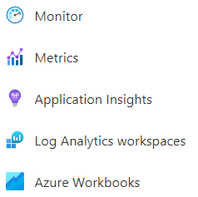
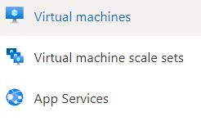


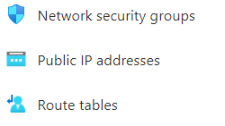



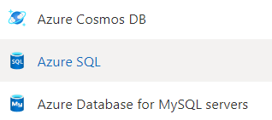

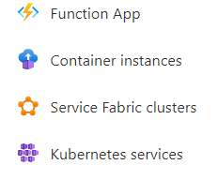

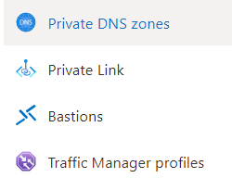





Azure Cloud Services
List Of Services

Slide 5
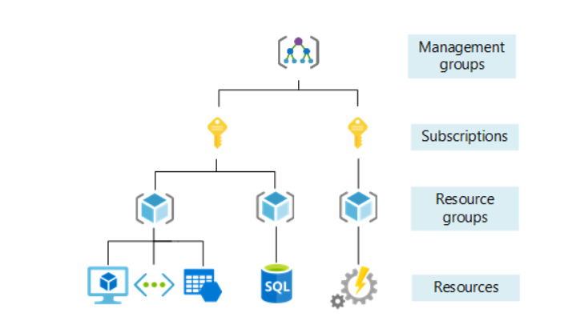
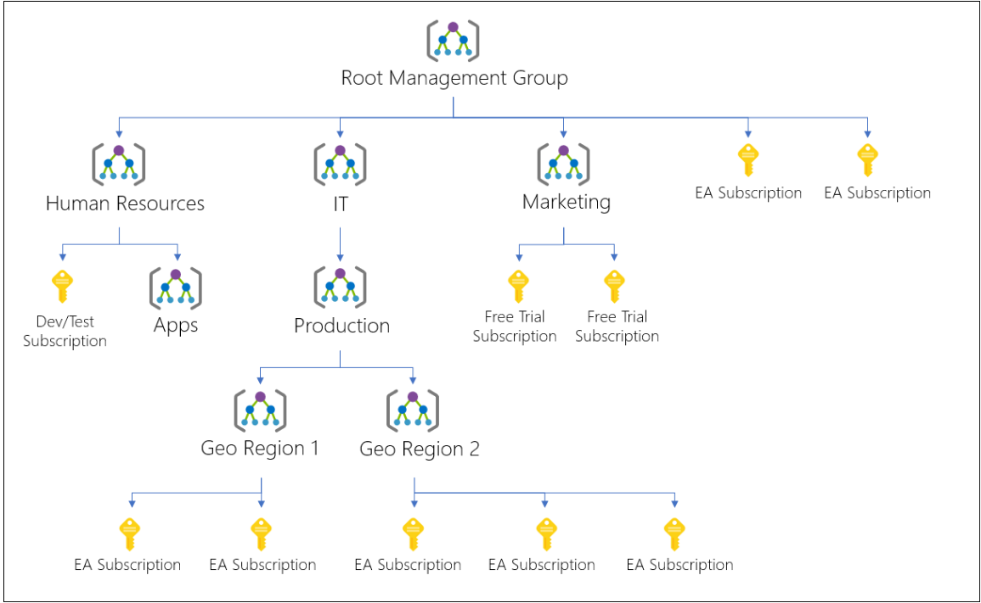
Azure Cloud Services
Hierarchy of Azure Resources

Slide 6
Azure Cloud Services
Tools for Deploying Azure Resources
Azure Portal – Graphical Interface which can accessible from browser or we can install azure desktop app
Cloud Shell - interactive, authenticated, browser-accessible shell. Either Bash or PowerShell commands
Azure CLI - set of commands used to create and manage Azure resources.
Azure PowerShell - a set of cmdlets for managing Azure resources directly from PowerShell
ARM Templates – JSON files that declare azure resources and deploy them to Azure cloud
Terraform – Open source tool used as Infrastructure as a Code to build, change and destroy the infrastructure

Slide 7
Azure Cloud Services
ARM Templates
ARM Templates are JSON files, to declare the objects you want, the types, names and properties and can be checked into source control and managed like any other code file
ARM Templates Schema
{
"$schema": "https://schema.management.azure.com/schemas/2019-04-01/deploymentTemplate.json#",
"contentVersion": "1.0.0.0",
"parameters": {},
"functions": [],
"variables": {},
"resources": [],
"outputs": {}
}
https://docs.microsoft.com/en-us/azure/azure-resource-manager/templates/template-tutorial-create-first-template?tabs=azure-cli

Slide 8
Azure Cloud Services
ARM Templates deployment methods
Incremental - In incremental mode, Resource Manager leaves unchanged resources that exist in the resource group but aren't specified in the template. Resources in the template are added to the resource group. It is Default method
Complete - In complete mode, Resource Manager deletes resources that exist in the resource group but aren't specified in the template.
az deployment group create --mode Complete or incremental
--name ExampleDeployment --resource-group ExampleResourceGroup --template-file storage.json
ARM Templates deployment Scope
Resource Group
Subscription
Management Group
Tenant

Slide 9
Azure Cloud Services
ARM Templates deployment Scope
Resource Group
{
"$schema": "https://schema.management.azure.com/schemas/2019-04-01/deploymentTemplate.json#",
"contentVersion": "1.0.0.0",
"resources": []
}
Az cli command: az deployment group create –template-file <path to template file>
Subscription
{
"$schema": "https://schema.management.azure.com/schemas/2018-05-01/subscriptionDeploymentTemplate.json#",
"contentVersion": "1.0.0.0",
"resources": []
}
Az cli command: az deployment sub create –template-file <path to template file>

Slide 10
Azure Cloud Services
ARM Templates deployment Scope
Management Group
{
"$schema": "https://schema.management.azure.com/schemas/2019-08-01/managementGroupDeploymentTemplate.json#",
"contentVersion": "1.0.0.0",
"resources": []
}
Az cli command: az deployment mg create –template-file <path to template file>
Tenant
{
"$schema": "https://schema.management.azure.com/schemas/2019-08-01/tenantDeploymentTemplate.json#",
"contentVersion": "1.0.0.0",
"resources": []
}
Az cli command: az deployment tenant create –template-file <path to template file>

Slide 11
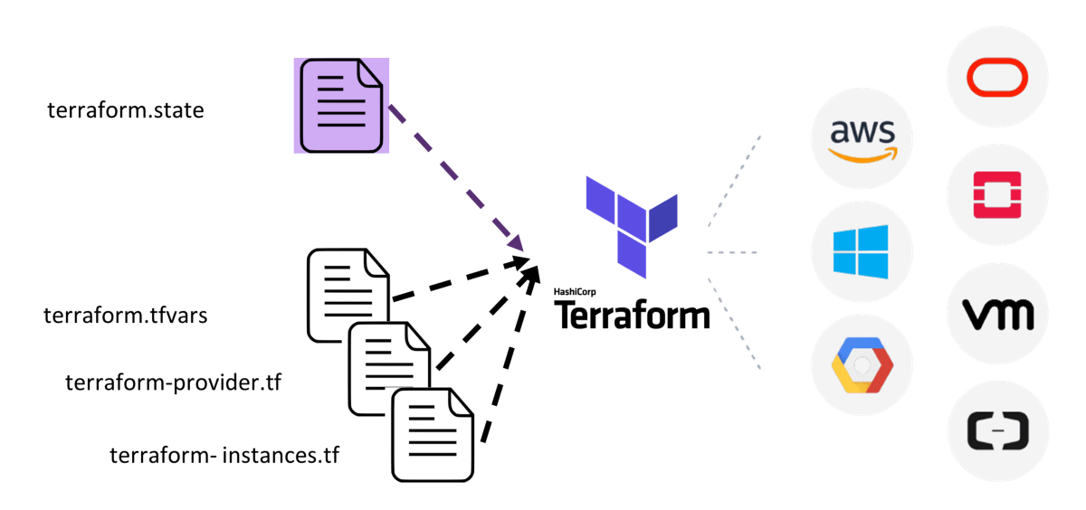

Terraform
Terraform is an infrastructure as code tool that lets you build, change, and version cloud and on-prem resources safely and efficiently.

Slide 12
Terraform - Components
Providers – Plugins to interact with cloud, on-premise and other APIs
Resources – components that we need to create in targets
Variables – to store the dynamic values to use in different env. With single configuration file
Statefile – After infra got created through terraform, Statefile will be created to save all information of current infrastructure.
Provisioners – will provide ability to run additional tasks when resource is created or destroyed.
Modules -- Modules are containers for multiple resources that are used together in a configuration
Backends -- Backends define where Terraform's state snapshots are stored.
Data Sources -- Data sources allow Terraform to use information defined outside of Terraform, defined by another separate Terraform configuration, or modified by functions

Slide 13
Azure Virtual Machines
Plan For Azure VMs:
Start with the network
Name the VM
Decide the location for the VM
Determine the size of the VM
Understanding the pricing model
Storage for the VM
Select an operating system
Connecting to VMs:
RDP (Remote Desktop Service): use it to connect with Windows VMs
SSH(Secure Shell): Use it to connect with Linus VMs
Bastion: use to connect with windows or Linux VMs securely from browser

Slide 14
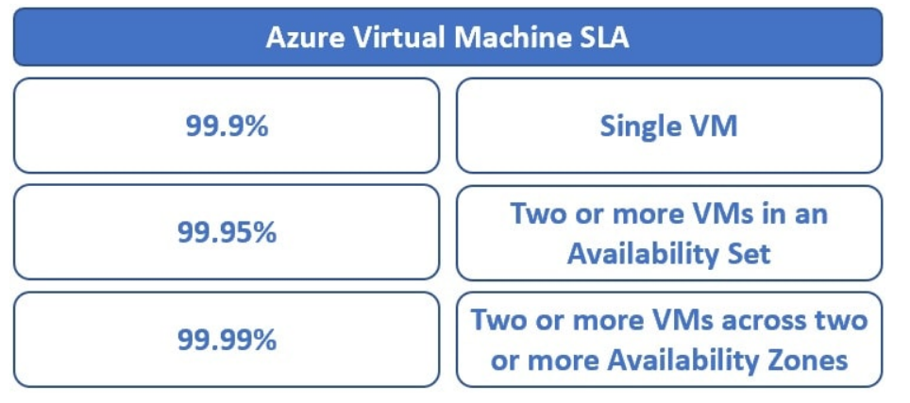
Azure VMs High availability
Availability sets
An Availability Set is a logical grouping for isolating virtual machine resources from each other.
Azure makes sure that the VMs we place in an Availability Set run across multiple physical servers, compute racks, storage units, and network switches
Availability Zones
Group of two or more azure datacentres in a region to provide redundancy and high availability

Slide 15
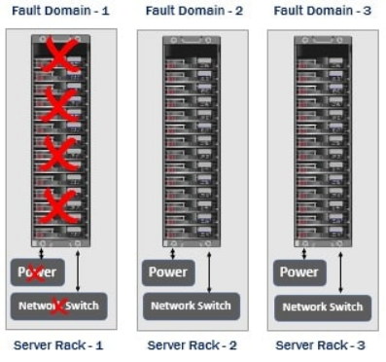
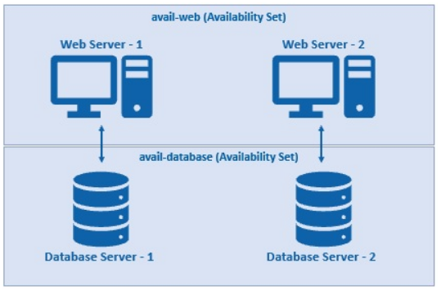
Azure Availability set
VMs should be deployed in Same region, vnet and resource group
Minimum 2 VMs should deploy to get benefit from Availability sets
SLA 99.95%

Slide 16
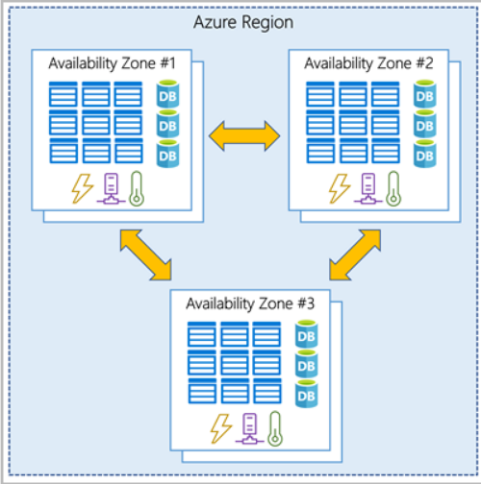
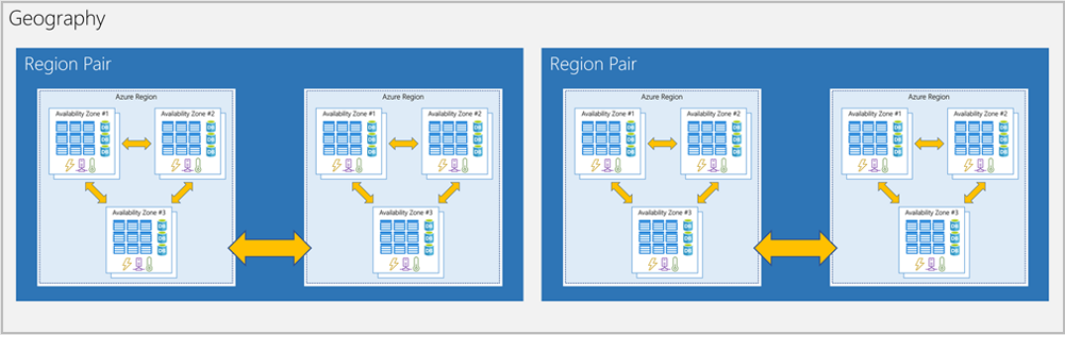
Azure Availability Zones
Disaster Recovery and Business Continuity scenario
SLA 99.99%

Slide 17
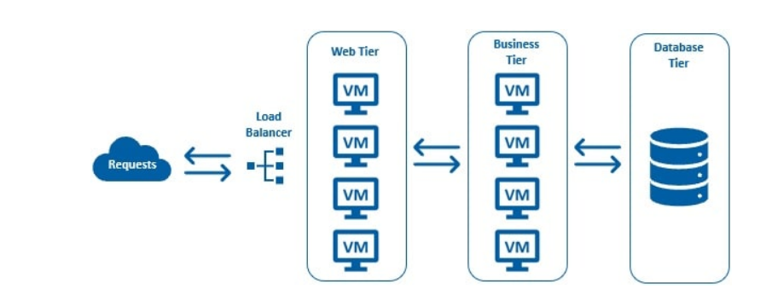
Azure VM Scale Sets
A Virtual Machine Scale Set lets us easily create and manage multiple virtual machines.
All VMs in a scale set are identical, meaning they are created from the same base operating system image and configuration.
Obviously, this approach lets us easily manage hundreds of VMs without additional configuration.
For traffic distribution, an Azure Load Balancer is also deployed along with the virtual machines in a scale set.
There is no need to manually create the virtual machines or the load balancer. Just imagine the amount of time it saves.

Slide 18

Azure Storage Account
An Azure storage account contains all of your Azure Storage data objects,
including blobs, file shares, queues, tables, and disks.
Azure Blobs: A massively scalable object store for text and binary data.
Also includes support for big data analytics through Data Lake Storage Gen2.
Azure Files: Managed file shares for cloud or on-premises deployments.
Azure Queues: A messaging store for reliable messaging between application components.
Azure Tables: A NoSQL store for schemaless storage of structured data.
Azure Disks: Block-level storage volumes for Azure VMs.

Slide 19
Azure Storage Account
Blob Types
Block blobs: store text and binary data, up to about 4.7 TB. Block blobs are made up of blocks of data that can be managed individually.
Append blobs: are made up of blocks like block blobs, but are optimized for append operations.
Append blobs are ideal for scenarios such as logging data from virtual machines.
Page blobs: store random access files up to 8 TB in size.
Page blobs store virtual hard drive (VHD) files and serve as disks for Azure virtual machines.

Slide 20
Azure Storage Account
Azure Storage Redundancy
Locally redundant storage (LRS) - copies your data synchronously three times within a single physical location in the primary region.
Zone-redundant storage (ZRS) - copies your data synchronously across three Azure availability zones in the primary region
Geo-redundant storage (GRS or RA-GRS) - copies your data synchronously three times within a single physical location in the primary region using LRS.
It then copies your data asynchronously to a single physical location in the secondary region
Geo-zone-redundant storage (GZRS or RA-GZRS) - copies your data synchronously across three Azure availability zones in the primary region using ZRS.
It then copies your data asynchronously to a single physical location in the secondary region.

Slide 21
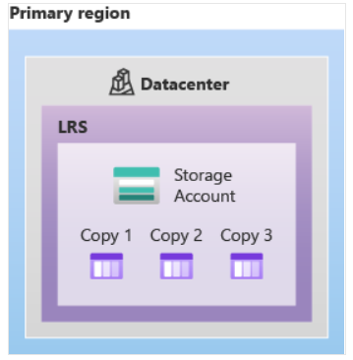
Azure Storage Account
Azure Storage Redundancy
Locally redundant storage (LRS)

Slide 22
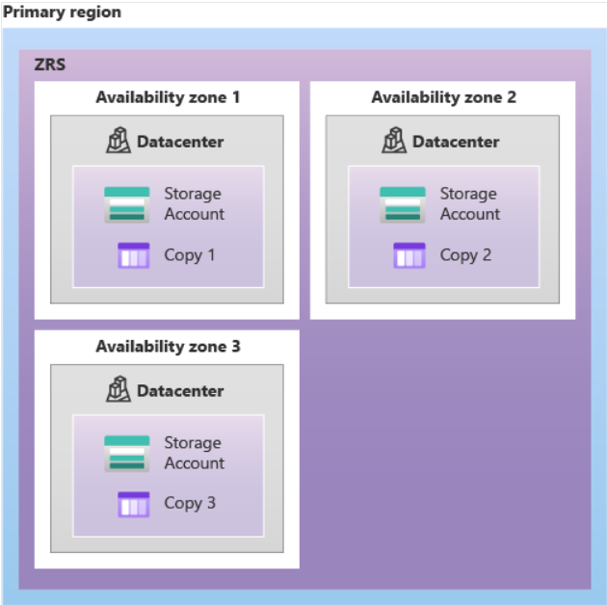
Azure Storage Account
Azure Storage Redundancy
Zone-redundant storage (ZRS)

Slide 23
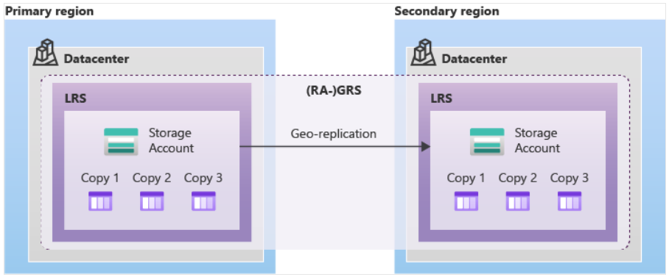
Azure Storage Account
Azure Storage Redundancy
Geo-redundant storage (GRS or RA-GRS)

Slide 24
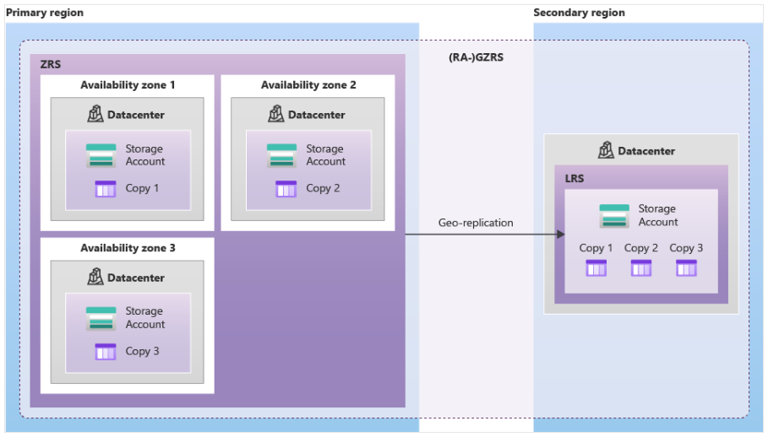
Azure Storage Account
Azure Storage Redundancy
Geo-zone-redundant storage (GZRS or RA-GZRS)

Slide 25
Azure Storage Account
Azure Storage Account types
Standard: This is the standard general-purpose v2 account and is recommended for most scenarios using Azure Storage.
Premium: Premium accounts offer higher performance by using solid-state drives.
If you create a premium account you can choose between three account types, block blobs, page blobs, or file shares.
Azure Blob Access tiers
Hot access tier: Optimized for storing data that is accessed frequently (for example, images for your website).
Cool access tier: Optimized for data that is infrequently accessed and stored for at least 30 days (for example, invoices for your customers).
Archive access tier: Appropriate for data that is rarely accessed and stored for at least 180 days, with flexible latency requirements (for example, long-term backups).

Slide 26
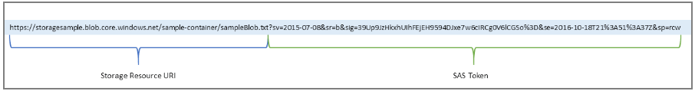
Azure Storage Account
Shared Access Signature
A shared access signature (SAS) provides secure delegated access to resources in your storage account.
With a SAS, you have granular control over how a client can access your data.
For example:
What resources the client may access.
What permissions they have to those resources.
How long the SAS is valid.
Storage Access Keys
When you create a storage account, Azure generates two 512-bit storage account access keys for that account.
These keys can be used to authorize access to data in your storage account via Shared Key authorization

Slide 27
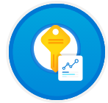
Azure Key Vault
Azure Key Vault is a cloud service for securely storing and accessing secrets. A secret is anything that you want to tightly control access to, such as API keys, passwords, certificates, or cryptographic keys
Key vault reference format:
@Microsoft.KeyVault(VaultName=myvault;SecretName=mysecret)
Alternate way:
@Microsoft.KeyVault(SecretUri=https://myvault.vault.azure.net/secrets/mysecret/)

Slide 28

Azure AppService
Azure App Service is a fully managed web application hosting platform. This platform as a service (PaaS) offered by Azure allows you to focus on designing and
building your app while Azure takes care of the infrastructure to run and scale your applications..
App Service plans
An App Service plan is a set of virtual server resources that run App Service apps. A plan's size (sometimes referred to as its sku or pricing tier)
determines the performance characteristics of the virtual servers that run the apps assigned to the plan and
the App Service features that those apps have access to.
Every App Service web app you create must be assigned to a single App Service plan that runs it.

Slide 29
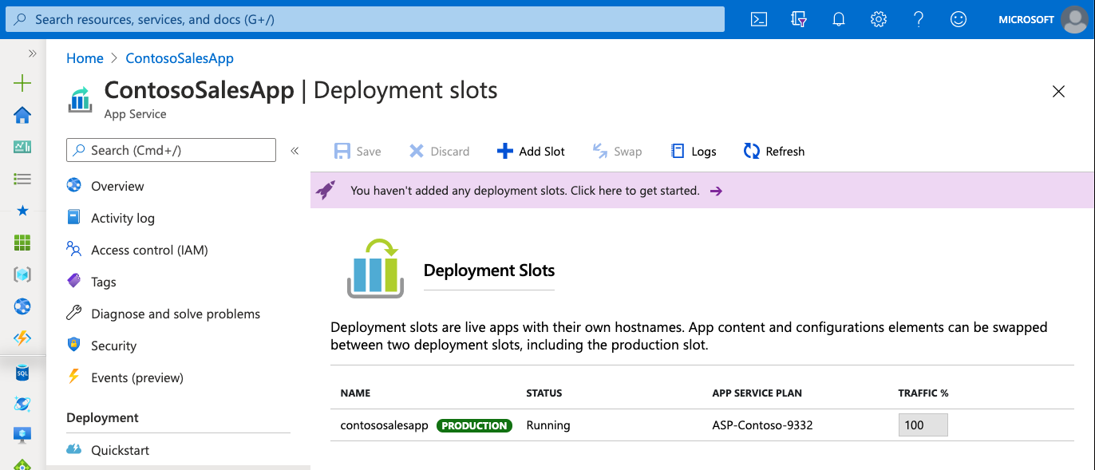
Azure AppService
Deployment slots
Using the Azure portal, you can easily add deployment slots to an App Service web app. For instance, you can create a staging deployment slot where you can push your code to test on Azure. Once you are happy with your code, you can easily swap the staging deployment slot with the production slot. You do all this with a few simple mouse clicks in the Azure portal.

Slide 30
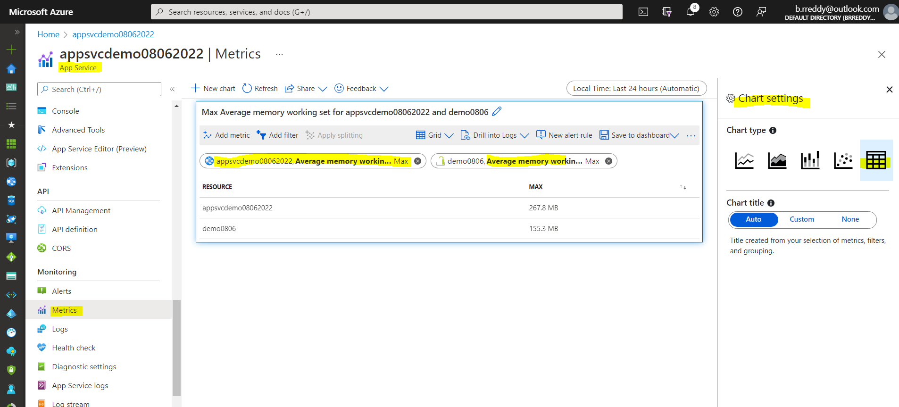
Azure AppService
To check the utilization of each app service in App service plan
Step1: Select the app service
Step2: Goto Metrics
Step3: Select the scope and metric as
Avg memory working Set
It will show as graph.
If we want see in Numbers
Click three dot at the right end and select the chart settings
And change to table

Slide 31

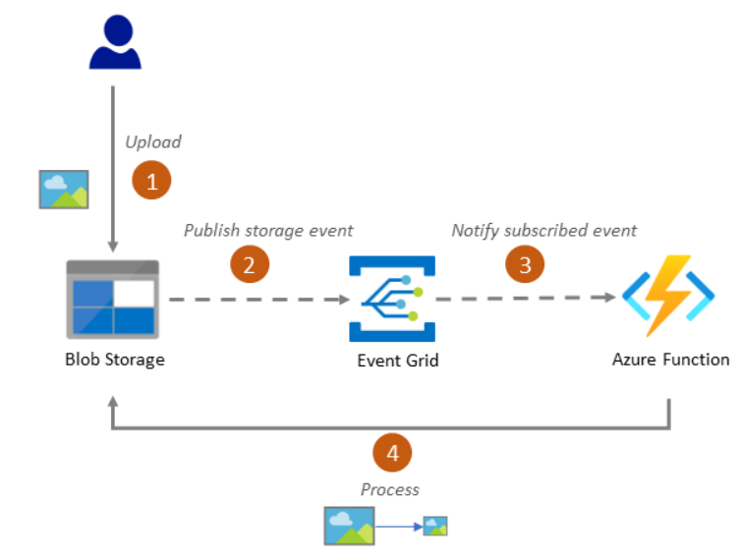
Azure Functions
Azure Functions is a serverless application platform. It enables developers to host business logic that can be executed without provisioning infrastructure. Azure Functions provides intrinsic scalability and you are charged only for the resources used. You can write your function code in the language of your choice, including C#, F#, JavaScript, Python, and PowerShell Core. Support for package managers like NuGet and NPM is also included, so you can use popular libraries in your business logic.
Serverless architecture
Event driven
Execution Time is not more than 10 minutes
Dataflow
A user uploads a photo to a Blob storage container.
Blob storage publishes storage object events to Event Grid.
Event Grid triggers an Azure Function, based on the event criteria that the Function subscribed.
The function retrieves the photo and runs the image process on it (such as to shrink an image). Then it saves the new image to another Blob storage container.

Slide 32
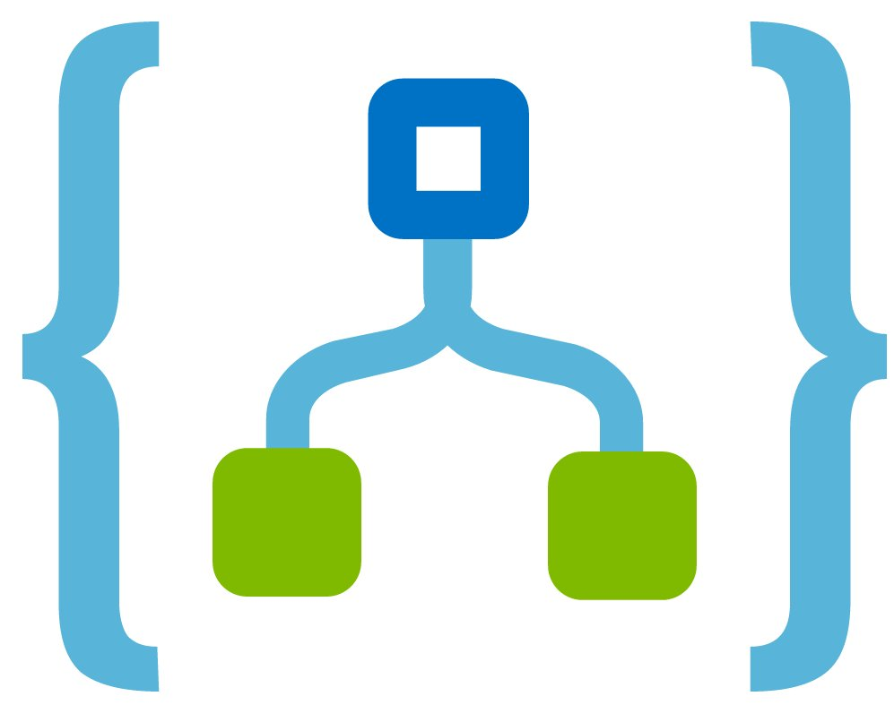
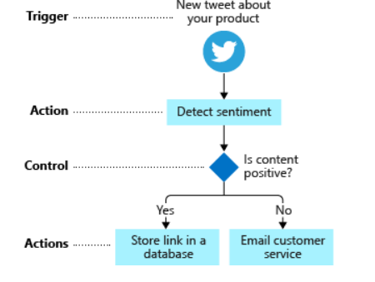
Azure Logic Apps
Azure Logic Apps is a cloud service that automates the execution of your business processes.
You use a graphical design tool called the Logic Apps Designer to arrange pre-made components into the sequence you need.
The designer sends a definition of your workflow to the Logic Apps execution engine.
The execution engine launches your app when conditions are right and manages the compute resources needed to run it.
A trigger is an event that occurs when a specific set of conditions is satisfied. Triggers activate automatically when conditions are met. For example, when a timer expires or data becomes available.
An action is an operation that executes a task in your business process. Actions run when a trigger activates or another action completes.

Slide 33
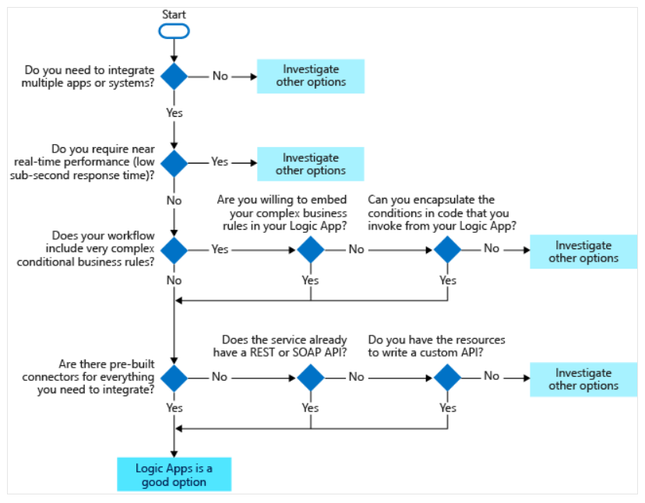
Azure Logic Apps
The following flowchart summarizes the key questions to ask when you're considering using Logic Apps.

Slide 34
Any Questions?

Slide 35
Thank you…!!!

